Slide 1

Review Scores Prediction
on Olist E-commerce Platform in Brazil
Mini-project presentation by FS6 Group 10
Luo Yihang U2022279G
Wang Qianteng U2022039K
Xue Yushan U2022049H

Slide 2




Motivation
E-commerce is gaining momentum throughout the world, so it is important to predict consumers’ demand.
Dataset: Olist E-Commerce and Marketing Datasets
2 sources:
Brazilian E-Commerce Public Dataset by Olist
Marketing Funnel by Olist

Slide 3
Problem Statement
What do customers concern most when shopping online?
To predict review scores
To find the most important factors affecting review scores
Aim: To improve consumer satisfaction and to recognize marketing trends!

Slide 4

Strategy
1
Exploratory data analysis on relevant variables
2
Three models to predict review scores
3
Compare the performance of the models
4
Find the feature importance

Slide 5
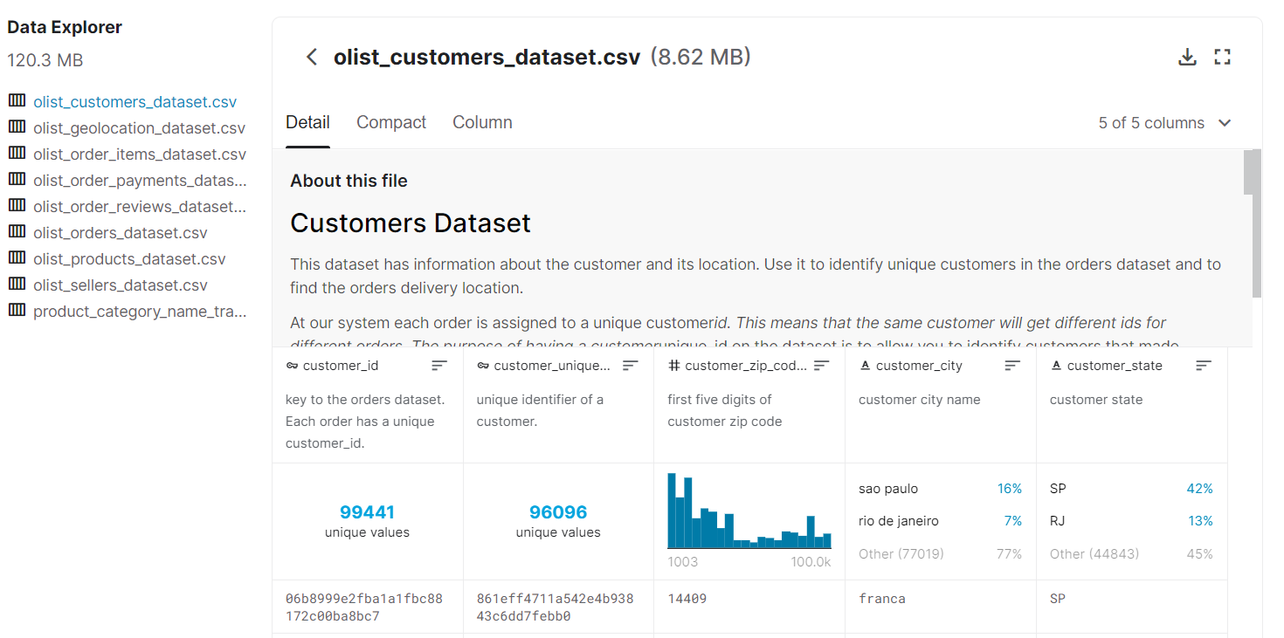
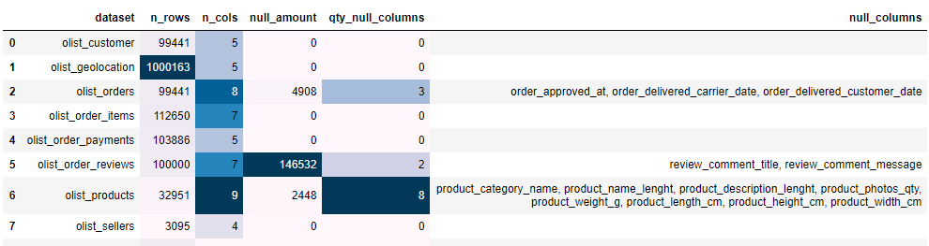
Data Preparation
Data Overview
Source1: Brazilian E-Commerce Public Dataset
Over 99 thousand e-commerce orders, including information about geolocation, product, review, seller, etc.

Slide 6

Data Preparation
Data Cleaning & Merging
Source1: Brazilian E-Commerce Public Dataset
Extracted variables:
Review scores (response)
Sales
Price
Freight value
Delivery time
Estimated delivery time
Product description length
Product photos quantity
Review sentiment
Product category
We took the average of each variable

Slide 7
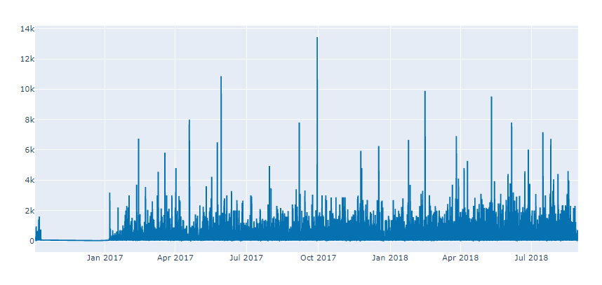
Exploratory Data Analysis -- Brazilian E-Commerce Public Dataset
Sales – in time series
Calculated by the sum of orders of each products

Slide 8
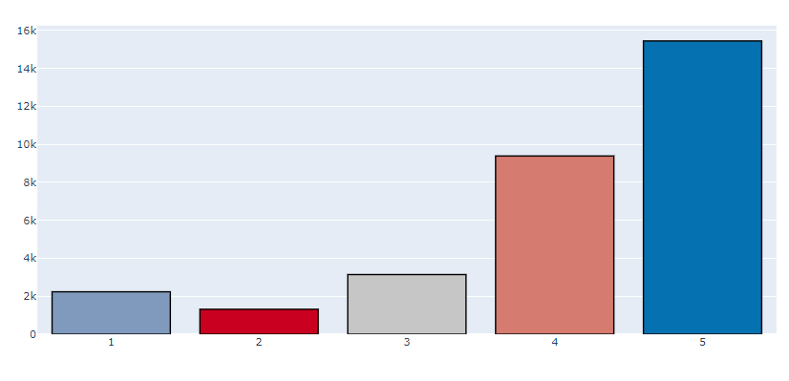
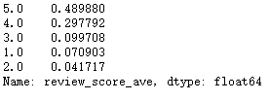
Exploratory Data Analysis -- Histogram of Numerical Data
Review score (response)
Proportion of each review score

Slide 9
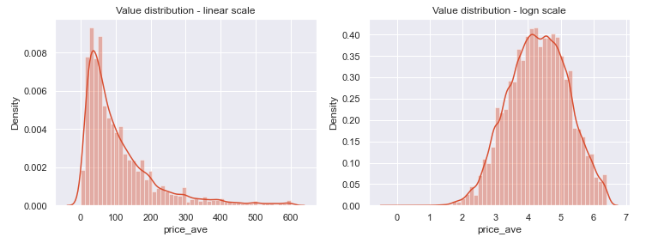
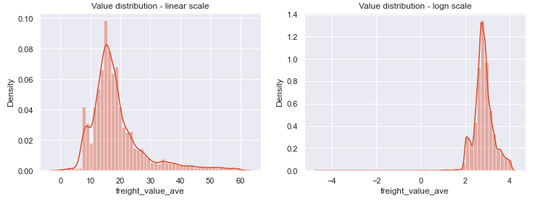
Exploratory Data Analysis – Histogram of Numerical Data
Average price
Average freight value

Slide 10
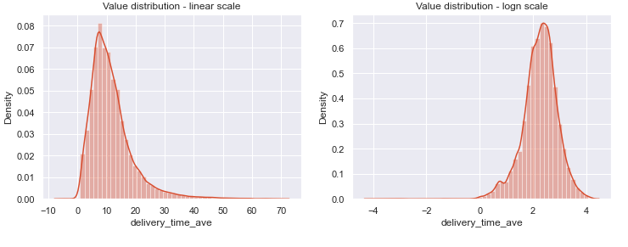
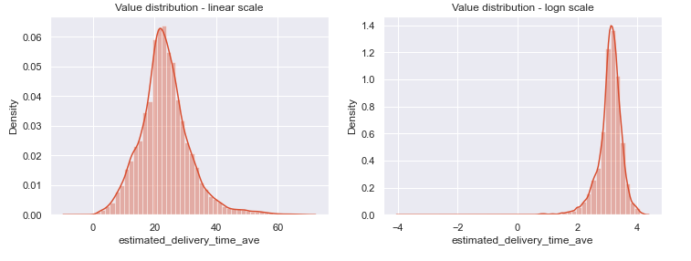
Exploratory Data Analysis -- Histogram of Numerical Data
Average delivery time
(delivered date - order approved date)
Average expected delivery time
(estimated delivered date – estimated order approved date)

Slide 11
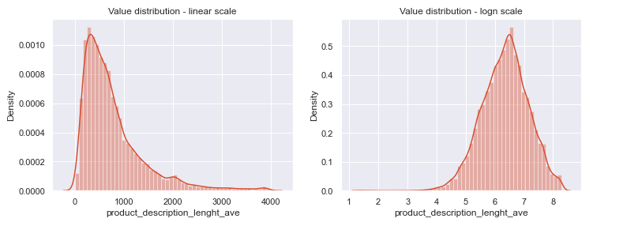
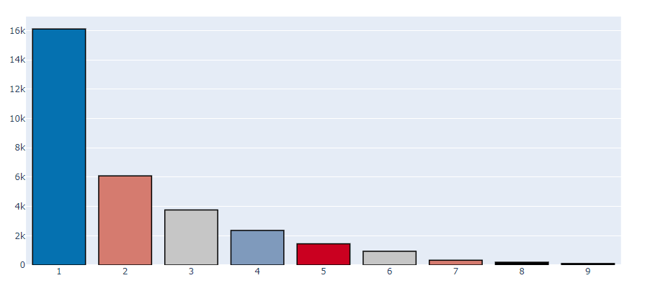
Exploratory Data Analysis -- Histogram of Numerical Data
Average product description length
Average product photos quantity

Slide 12
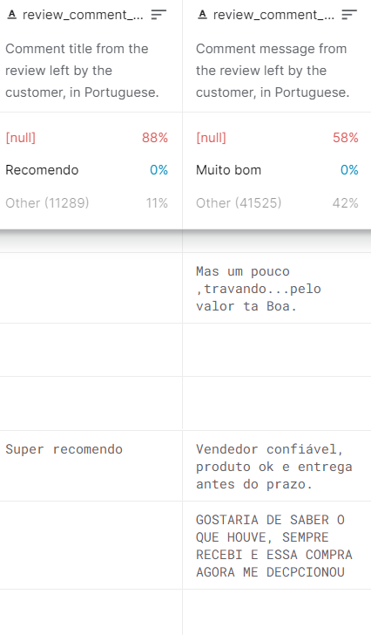
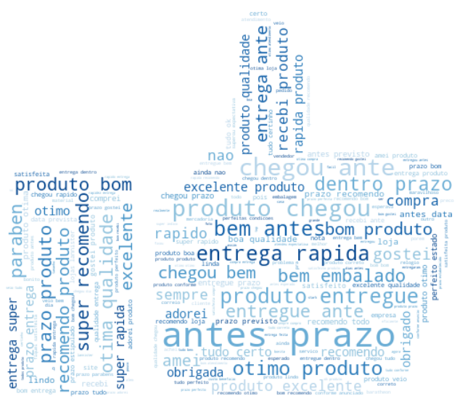

Exploratory Data Analysis – Review Sentiment
Sentiment Analysis
Other’s reviews can affect a consumer’s decision
API used: SentiStrength – to evaluate reviews
Positive score: 1 to 5
negative score: -1 to -5
Add two columns: positive_ave, negative_ave
Provide more information on customers satisfaction

Slide 13
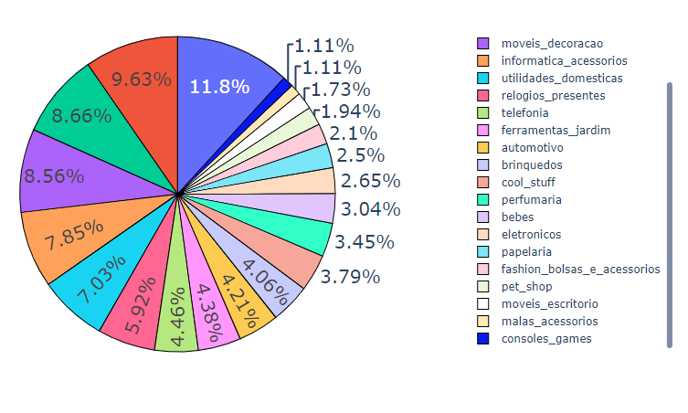
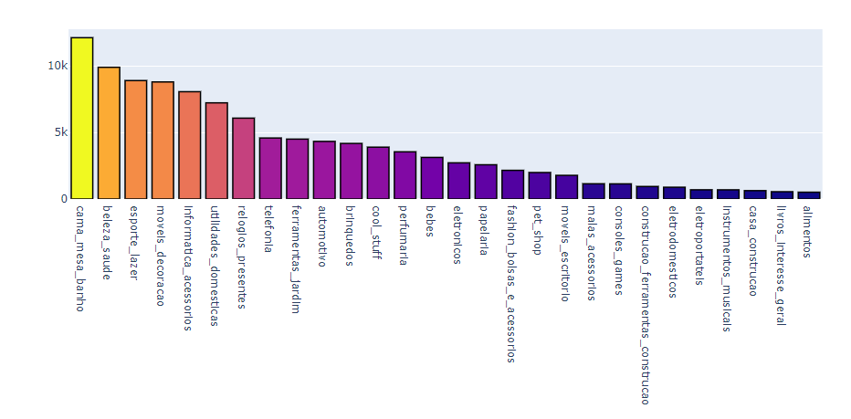
Exploratory Data Analysis – Pie Plot & Catplot of categorical data
Product Category
Top 3 best-selling categories:
Bed & bath & table
Health & beauty
Sports & leisure

Slide 14
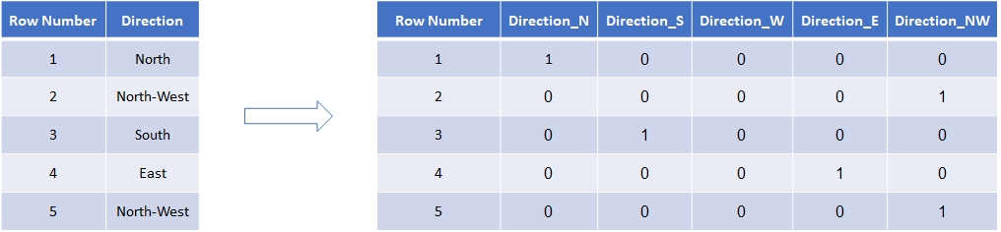
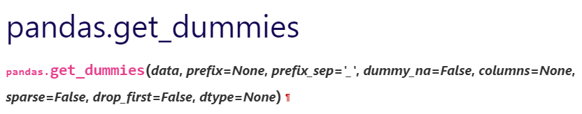
Exploratory Data Analysis – One-hot Encoding
Use one-hot encoding to deal with product categories
Transformed the categories into new dummy variables with a value of 1 or 0
Benefits: Make categorical data more expressive for the machine learning algorithms

Slide 15
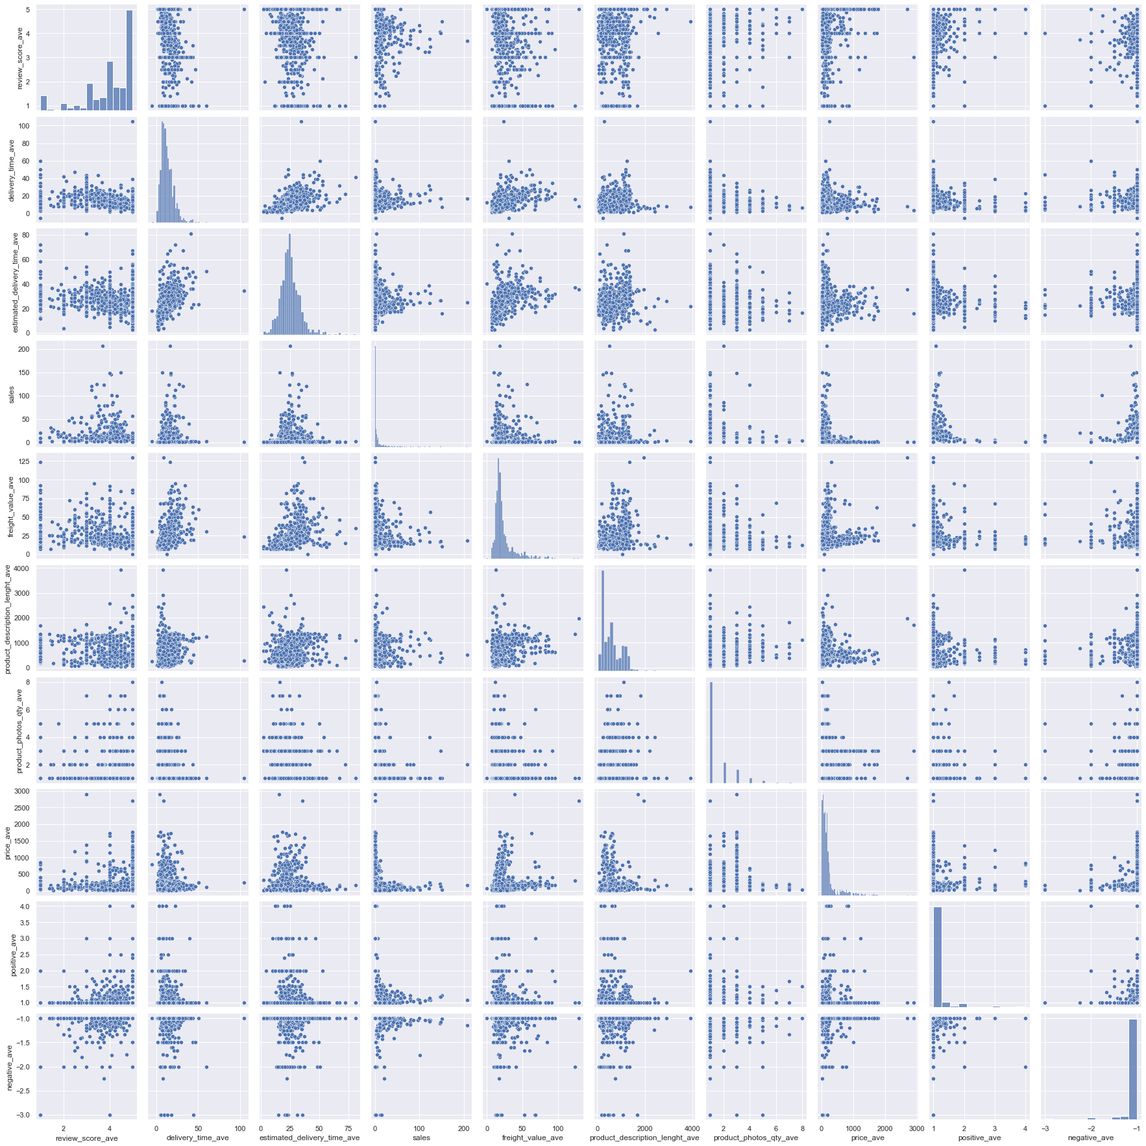
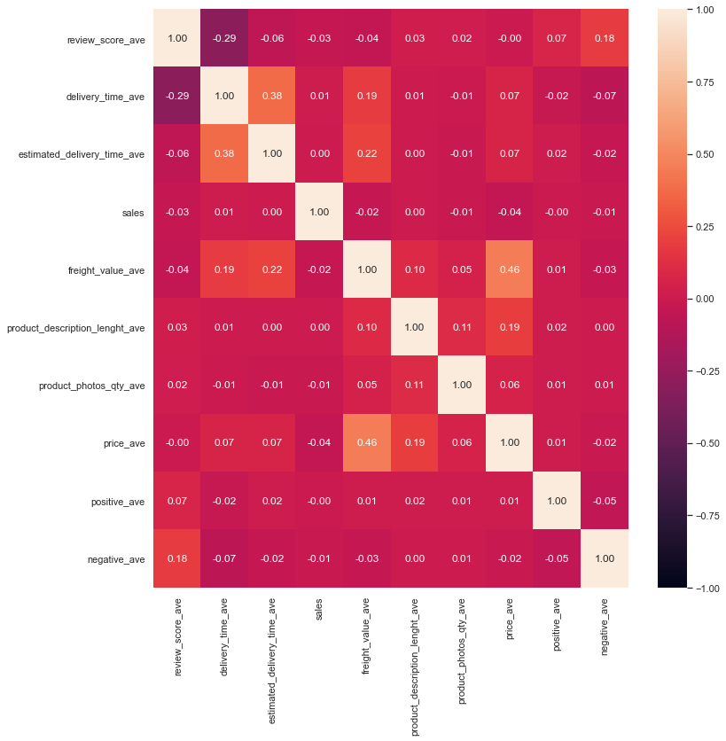
Correlation analysis (10 numerical variables)
Joint plot
Correlation heatmap
Observation: For each pair of variable, there is little correlation between it and other variables
Reason: It is a real-life dataset containing a very large amount of data
Solution: Multi-variate regression

Slide 16

Data Processing
Train-test splitting
Method: Stratified Shuffle Split
Train set :80%
Test set : 20%
Three regression models we used
Linear Regression
Random Forest
K-nearest Neighbours (KNN)
New models besides course content!

Slide 17

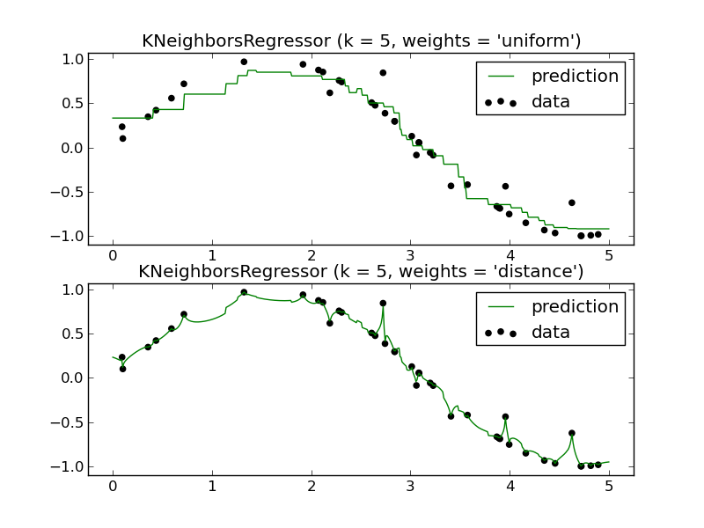
Data Processing
Benefits of the two new models
Random Forest
Higher accuracy
Easy to measure the relative importance of each variable
K-nearest Neighbours (KNN)
Higher accuracy
Simple algorithm

Slide 18
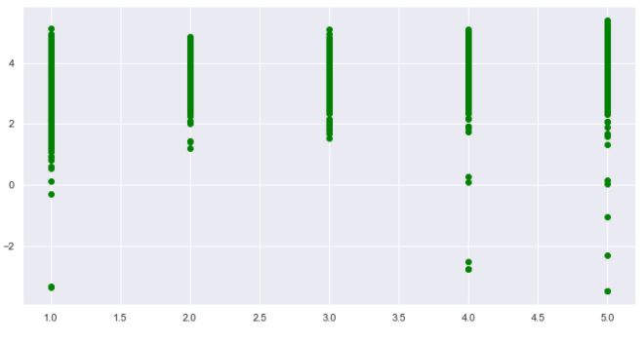
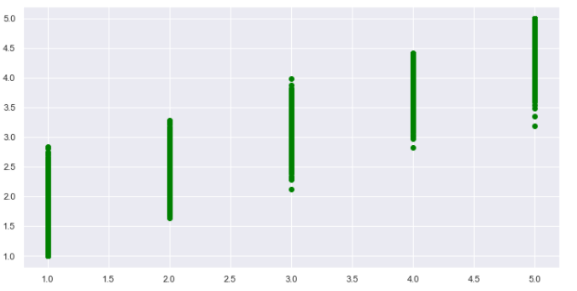
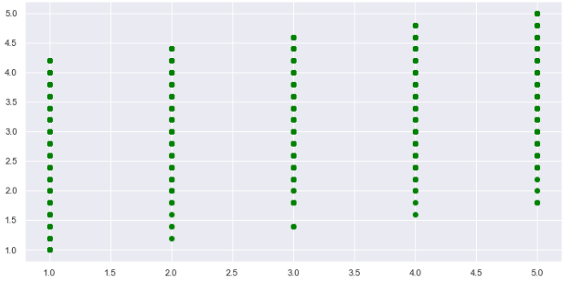
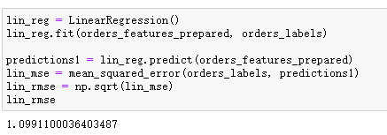
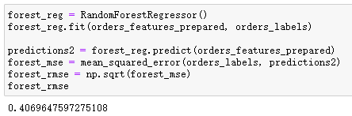
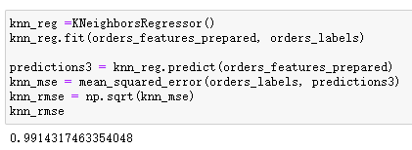
Results of Regression – Comparison (train set)
Linear Regression
Random Forest
√
KNN
Plot of predicted - actual value
Root mean square error (rmse):
≈1.0991
≈0.4070
≈0.9914
Least rmse -> highest accuracy

Slide 19
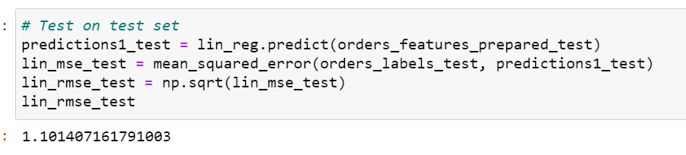
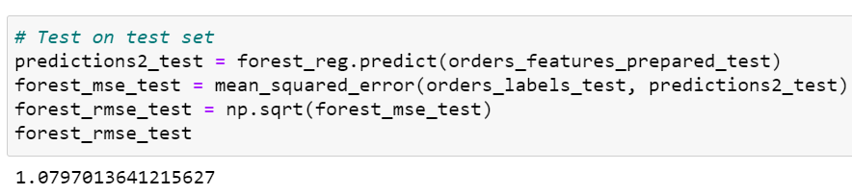
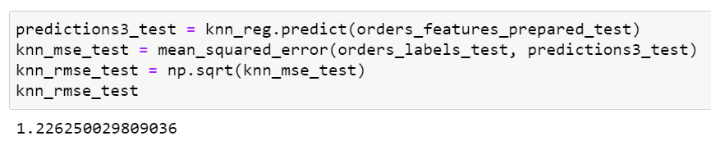
Results of Regression – Comparison (test set)
Root mean square error (rmse) on test set:
Linear Regression
≈1.1014
Random Forest
≈1.0797
KNN
≈1.2263

Slide 20
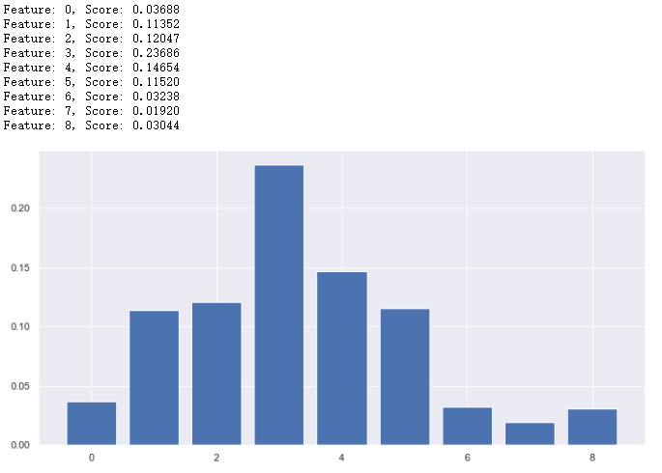
Results of Regression
Feature importance of numerical variables – Random Forest
Top 3 important variables
Freight value
Estimated delivery time
Actual delivery time
Less important variables
Product photo quantity
Positive and negative review strength
Sales
Price_ave
Freight_value_ave
Delivery_time_ave
Estimated_delilvery_time_ave
Product_description_lenght_ave
Product_photos_qty_ave
Positive_ave
Negative_ave

Slide 21
Outcome of Project – Conclusion & Recommendations
Conclusion
Among the three regression models, Random Forest can best predict reviews scores using the 9 numerical and categorical variables.
From the result, freight value, estimated and actual delivery time are the primary concerns of customers.
Recommendations for Olist company:
Improve delivery services
Try reducing delivery cost and time

Slide 22
Outcome of Project – Learning Something New
New data science skills learned
Methods to analyse feature importance
Basic understanding of natural language processing
New models & data visualization tools learned
Regression and classification models like Random Forest and KNN model
Use Plotly to create interactive visuals & Matplotlib to create wordcloud

Slide 23

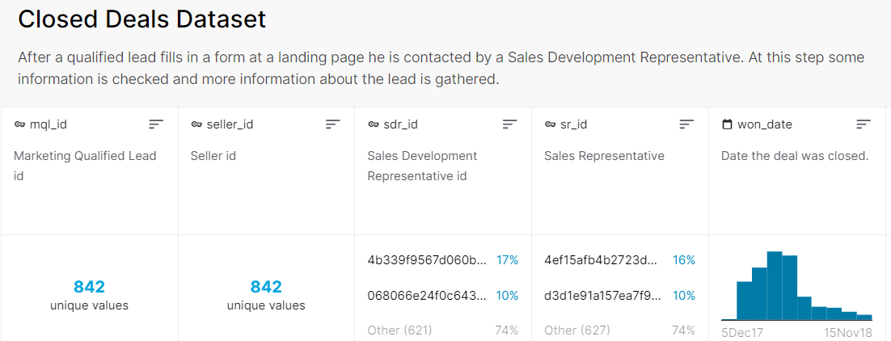
Further research direction
The dataset of sellers contains very limited information.
Olist may build a more complete dataset on sellers to study how the factors about sellers affect customer satisfaction.
Only 842 available values

Slide 24

Division of work
Luo Yihang
Clean and process the data in source 1
Learn and use the regression models
Do the EDA part and make data visualizations
Organize and integrate all codes
Edit the final presentation video
Wang Qianteng
Write the script for the project presentation
Search information about the variables’ importance analysis
Learn to use api to process and evaluate the review sentiment
Make the detailed plan for the project
Make the final presentation
Xue Yushan
Clean and process the data in source 2
Learn and use the regression models
Do the EDA part and make data visualizations
Make the presentation PowerPoint slides

Slide 25
References
https://link.springer.com.remotexs.ntu.edu.sg/content/pdf/10.1007/s10257-019-00438-3.pdf
https://blog.minitab.com/en/adventures-in-statistics-2/how-to-identify-the-most-important-predictor-variables-in-regression-models
https://machinelearningmastery.com/calculate-feature-importance-with-python/
https://towardsdatascience.com/categorical-encoding-using-label-encoding-and-one-hot-encoder-911ef77fb5bd
http://sentistrength.wlv.ac.uk/
https://online.stat.psu.edu/stat504/lesson/6/6.1
https://scikit-learn.org/stable/modules/generated/sklearn.preprocessing.OneHotEncoder.html
https://plotly.com/python/mapbox-density-heatmaps/
https://www.analyticsvidhya.com/blog/2018/08/k-nearest-neighbor-introduction-regression-python/

Slide 26
Thanks for your watching!
Review Scores Prediction on Olist E-commerce Platform in Brazil
Mini-project by FS6 Group 10
Luo Yihang U2022279G
Wang Qianteng U2022039K
Xue Yushan U2022049H

